Slide 1


Single Core Current Sensor: Voltage A/D Optimization
11/4/13
Andrew Meintz
586-859-3905
Form Revised 5/30/12
2012 Copyright General Motors - GM Information
1
Notes:
Instead of putting all directions on the slides, they will be in the speaker notes. The notes will add more detail to the comments that are on the slide.
This is your project file, add more slides and information, or delete the slides that don’t fit your work.

Slide 2
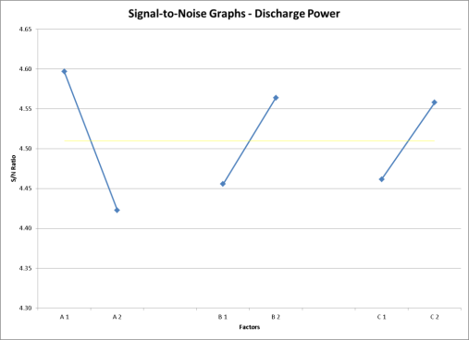
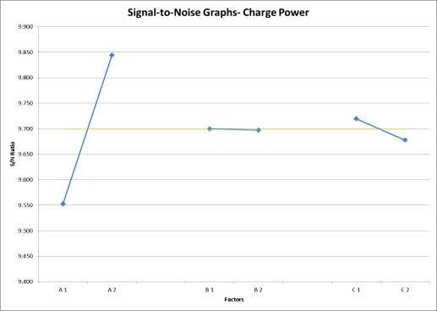
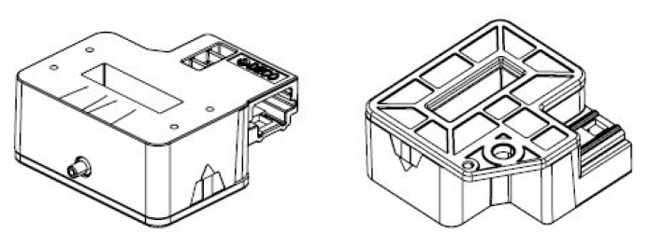
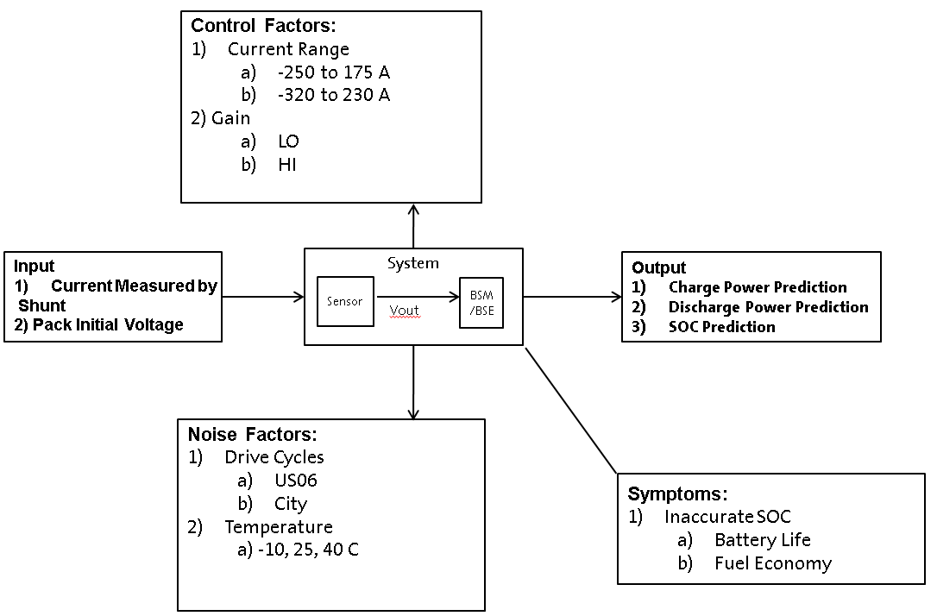
Title: Single Core Current Sensor: Voltage A/D Optimization
Project Leader: Andrew Meintz
Project Sponsor: Paul Kelley
Project: # XXX
DFSS Coach: Dave Osterman
Project Scope
Findings / Learnings
Proposal to change current sensor range calibration
Potential improvement to Power and SOC prediction
resulting in improved vehicle FE and Performance
Calibration changes to reduce range are not beneficial due to
contradiction in response from charge to discharge power
Part-to-part variation is important and was demonstrated
to affect power and SOC prediction error.
P-diagram
Implementation
No changes to the calibration are proposed as a result of this study.
Possible changes to the current sensor hall-effect IC will be investigated by Hannah Bence and Andrew Meintz and will be reviewed in the BAS3 and HEV4 PDTs.
Benefits
Identification of a method to analyze current sensor accuracy has been developed and can be re-used for future programs.
Quantitative analysis has demonstrated that the current sensor range is appropriate for this vehicle application.
Notes:
After you completed the summary slide, please move it to Slide 2.

Slide 3
Team Roster
I
D
D
O
V
Position | Name(s) | Responsibilities
Team Leader DFSS project credit | Andrew Meintz | Develop project plan Execute project – deliver on time and to plan Schedule and lead team meetings Generate and maintain standard project documentation Communicate project progress / status to Sponsor and DFSS Coach
DE / DRE / Subject Matter Expert | Hannah Bence Kelly Green | Provide design data Assignments in area of expertise
Critical Project Contributor DFSS project credit | Paul Groshek Ashley McAllister Hannah Bence Dave Osterman Eric Wills | System models, create and exercise math model(s) / transfer function(s) Generate experimental data to create / validate transfer function(s)
Quality |  | Quality data from plant, supplier, etc., gage R&R, process capability Warranty analysis, JDPower data
Manufacturing |  | Manufacturing data, expertise, BOP expertise
BOM Family Owner (BFO) |  | Group and present project results into product and process learnings Identify any new engineering tasks, methods, analysis procedures, tools or instructions to appropriate expert team
Statistical Support |  | Statistical expertise, DOE, reliability tools, and Response Surface methodologies
DFSS Coach DFSS project credit | Dave Osterman | Coach the Team Leader, train the team, assist in team startup, attend team meetings, participate in all DFSS technical reviews
Engineering Center Sponsor (Director)GFL DFSS project credit | Paul Kelley | GM management that will review the finished work. Owner of the resources to get the project done.
Notes:
These are the engineers that will help with the project. Not all boxes have to be filled, and not all people have to be at each meeting. Team members can do multiple positions. If you do not need the position, just put in N/A (not applicable).
Proof of certain team member participation on a project is required for DFSS Green Belt certification. Only these 4 positions (Team Leader, Critical Project Contributor, Coach, Sponsor) can use the work for certifications. See the DFSS webpage: http://gmna1.gm.com/vp/sedfss/ under DFSS Certification Requirements.

Slide 4
Project Charter
I
D
D
O
V
Vehicle Program(s)* | E2XX, K2XX, C1XX, 31XXN
Model Year(s)* | 2016+
Vehicle Line(s)* | BAS3.x, HEV4
SMT or Integration Area* | Electrification
QRD Focus Area* | 7N
BOM Row #* | 846
Start Date (proposed or actual) | March 8, 2013
Targeted End Date | June, 2013
Required End Date | June, 2013
Champion (Exec. Director) | Larry Nitz
Program Sponsor | Tim Grewe, Stephen Poulos
Engineering Center Sponsor (Director) | Bill Wallace
This information* is required to post completed DFSS projects in GDM.
Notes:
Project Charter is required to post in GDM.

Slide 5
I
D
D
O
V
Opportunity Statement / Expected Outcome
Opportunity Statement: Perform a robust assessment of the current sensor range and gain calibrations to improve measurement accuracy while maintaining use over multiple hybrid battery applications. Improve battery system requirements to relate algorithm, electronics and current sensor specifications.
What’s in it for the customer, what is in it for GM? Utilizing one sensor across multiple programs will reduce cost and complexity. Perform a robust assessment of the current sensor range and gain calibration. This will help with fuel economy and power prediction.
Expected Outcome (Specific Deliverables to the program): Identify critical factors that will allow us to select robust calibration.
Constraints: Component restrictions.
Notes:
Opportunity statement:
A plain language description of the basis for the project and the intent or goal of the team. Don’t feel restricted to one or two sentences.
“This is what precipitated the need for the project, here is what we would like to accomplish”
What’s in it for the customer/GM:
A quick statement of what the final buyer will get and what GM will get for our business.
Expected outcome:
A plain language description of what is desired out of the project:
A new VTS / SSTS Requirement
A design best practice
An assessment of the design robustness
A design configuration that meets program / business requirements
Constraints:
A brief listing of any constraints that have or will influence the scope, timing, impact, etc. of the project.

Slide 6
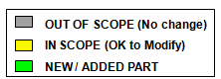
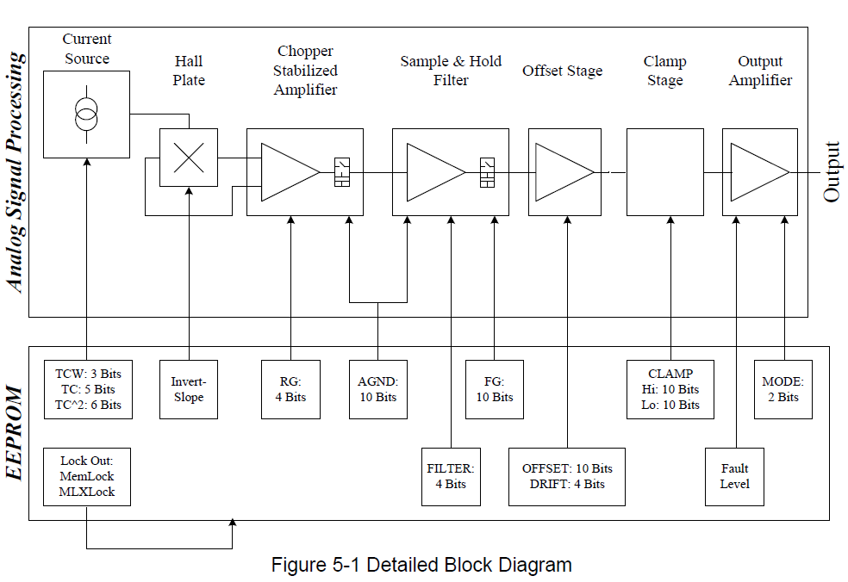
I
D
D
O
V
Scope / System Boundaries
Current Sensor
Notes:
Scope/System Boundaries
A brief listing of any scope/system boundaries identifies what component or systems are in scope, out of scope, or added/new part.
This summary can be captured with illustrations, structure diagrams, block diagrams, Bill of Materials, etc.

Slide 7
I
D
D
O
V
Data Support for Identified Opportunity
Reduce Validation Costs – Common Part across multiple programs (Hannah) (include estimated cost savings)
Currently paying ~ $40K for Current Sensor Validation, so if a new sensor were developed for a different programs this would be the cost to validate the sensor.
Reduce Enterprise Costs – Common Part (include estimated cost savings)
Piece Cost savings due to volume discount for reusing sensor across multiple programs:
$0.10 savings per vehicle = $41.5 K
3) Current Sensor Core has wider range than needed
4) Improve Battery Performance-> Improve Fuel Economy
Notes:
This is where you can put background data to support the Opportunity of the project. List current warranty output, cost of the baseline or any other data that explains the question of “Why is this important to work on”.
If you don’t need this, just delete the slide.

Slide 8
I
D
D
O
V
Project Plan
Identify Range of BAS3/HEV4 (Paul/Andrew)--- Start: 2/15/13, Complete: 3/8/13
Identified Current Sensor Design/Interface/Control (Hannah)---Start: 2/15/13, Complete: 6/14/13
Identified BSM A/D, Diagnostics (Dave) – Start: 2/15/13 , Complete: 4/25/13
A) Reducing Current Sensed Range – Start: 5/3/13 , Complete: 6/7/13
B) Reduce Quantization Error– Start: 5/3/13 , Complete: 6/14/13
C) Define Deadbands– Start: 5/3/13 , Complete: 5/16/13
D) Test All 4 Current Sensors on BAS3 Pack, Start: 6/24/13, Complete: 7/15/13
1) Build Test Harness, Start: 6/10/13, Complete: 6/28/13
2) Write Test Script, Start: 6/10/13, Complete: 6/28/13
E) Analyze Results – Start: 7/15/13 , Complete: 8/29/13
1) Ideal Source: Current shunt
2) Old Cal: -320 to 230 A
3) New Cal: No change as a result of this study.
5) Propose New Requirements and Complete Project – Start: 8/29/13 , Complete: 11/8/13

Slide 9
Customer Wants and Requirement Linkage
I
D
D
O
V
Vital Few Functional Requirements Selected for Project
Customer Expectation | Target LTB/STB/NTB | Functional Measure (Units) | Evaluation Method
Accurate Charge Power Prediction | STB | % Error | Comparison between BSE estimated power and measured power with characterization pulse
Accurate Discharge Power Prediction | STB | % Error | Comparison between BSE estimated power and measured power with characterization pulse
Accurate SOC Prediction | STB | % Error | Comparison between BSE estimated SOC and measured OCV after pack is allowed to equilibrate.
Notes:
This is the summary of the DEFINE stage. There should be a strong link between the Identified issue and these few requirements that will be worked on in the project.
If there are other requirements that are important, but won’t be addressed by the project (like constraints). You have the option of including those in additional slides. Example) latch must satisfy MVSS-2XX,

Slide 10
Baseline Design (Current)
I
D
D
O
V
Show the details (sketches, illustrations, etc.) of the baseline design.
VCC
Hall IC
100nF
GND
100nF
Sensor output
Sensor output[V]
4.8V
4.5V
2.8273V
-360A
-320A
+230A
+270A
0A
Applied current[A]
0.5V
0.2V
Notes:
Concept Selection Preparation
Choose a baseline for comparison with other concepts (designs, suppliers, alternatives, processes, etc.)
Use sketches, drawings, models, written words, or data to define each concept.
Describe each concept to an equal level of detail.
Choose a baseline for comparison with all other concepts.
Current design (don’t pick if a poor concept)
Strong competitive design (if not baseline, include in analysis)

Slide 11
Ideal Function Thinking
I
D
D
O
V
Output units
Estimated
SOC (%)
Improvement direction
Signal units
Rested (OCV-SOC)
Output units
Output units
Estimated
Charge Power
(kW)
Estimated
Discharge
Power (kW)
Improvement direction
Improvement direction
Signal units
Signal units
Actual Power (kW)
Actual Power (kW)
Plots of Test Data have been included in Back-Up Analysis section.
Notes:
Describe the Ideal Function include the following: Output, what the design is to suppose to do. Signal, what drives the system to give more response. Improvement direction, do you want to increase or decrease the slope.
Is the ideal function is assumed linear, is it? Discuss what would be an ideal relationship and how you will approach that in the projects.
If the project is not dynamic, delete this slide.

Slide 12
Parameter Diagram
I
D
D
O
V
Control Factors:
Current Range
-250 to 175 A
-320 to 230 A
2) Gain
LO
HI
Input
Current Measured by
Shunt
2) Pack Initial Voltage
System
Output
Charge Power Prediction
Discharge Power Prediction
SOC Prediction
Sensor
BSM
/BSE
Vout
Noise Factors:
Drive Cycles
US06
City
Temperature
a) -10, 25, 40 C
Symptoms:
Inaccurate SOC
Battery Life
Fuel Economy
Notes:
Create a Parameter Diagram. (Delete the input if it is non-dynamic) System is what is being studied, input and output should have engineering units. List the noise factors being included in the study. List control factors being studied.
List problem symptoms and concerns for the system. They may need to be checked when the project is complete.

Slide 13
Control & Noise Strategy
I
D
D
O
V
The table to the left describes the control factors and noise strategy for this study. The gain refers to the input gain, where the higher number defines the 1st stage gain in a two stage system. The range of the system is defined where Range 1 = -250 to 175 A and Range 0 = -320 to 230 A. The orthogonal array below has been used for the for the upcoming response plots in this document.
a1=small range | b1=high 1st stage gain
a2= large range | b2= low 1st stage gain
The criteria assessed for each current sensor is the % error of the SOC, charge power, and discharge power prediction as made by the Battery System Estimator (BSE) algorithm. This was accomplished in the study with a noise strategy of 2 drive cycles with 3 temperatures. In the drive cycles the current and voltage response of a pack is measured and is post-processed with the BSE.
The drive cycles were modified to contain both a maximum charge and discharge pulse toward the end of the cycle. These pulses were compared with the BSE predicted power capability just before the pulse occurred to develop the % error of power prediction for each sensor.
The SOC prediction at the end of the cycle was compared to the rested OCV of the test pack after it was allowed to equilibrate for 2 hours.
The noise strategy chosen was devised to include temperature variation effect and the current vs voltage response induced from high throughput and lower throughput drive cycles. Noise factors such as cell-to-cell temperature variation, capacity variation, voltage sensing, and thermistor error were considered outside of scope for this study.
Notes:
Detailed discussion of the approach to the noises in the study. You need to state the list of noise factors and the levels they will be studied. The next question is what strategy will be used in the outer array for the noises. Remember, compounding is just one method, if it is easy to get data, you may want to run all combinations.
Also list the noises that the team discussed and decided not to study. This will help answer the question “did you consider this….”

Slide 14
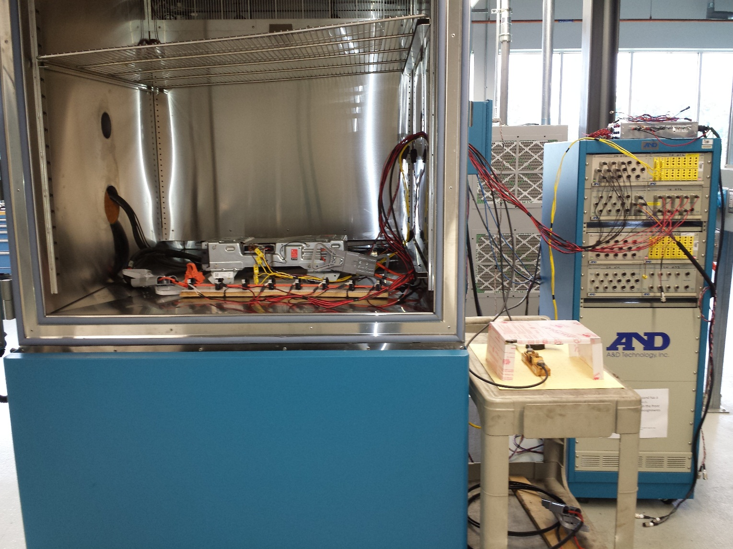
Optimization Details
I
D
D
O
V
Test setup
Environmental Chamber
Control temperature and humidity
Cycler
Control current and voltage of the battery pack
BAS 3.0 Battery Pack
I/O Rack
Used for data collection
Current sensors under test
With the same HV wire running through all of them (see next slide)
Current Shunt
To provide high accuracy current value
Notes:
Plot the data of your response. It is helpful to see the data that is used for summary statistics (i.e., S/N) before you analysis the Design of Experiment.
Give more detail as to the specifics of the optimization. Where appropriate, show the DOE matrix used as well as the analysis of the experiment. DELETE the examples when finished.

Slide 15
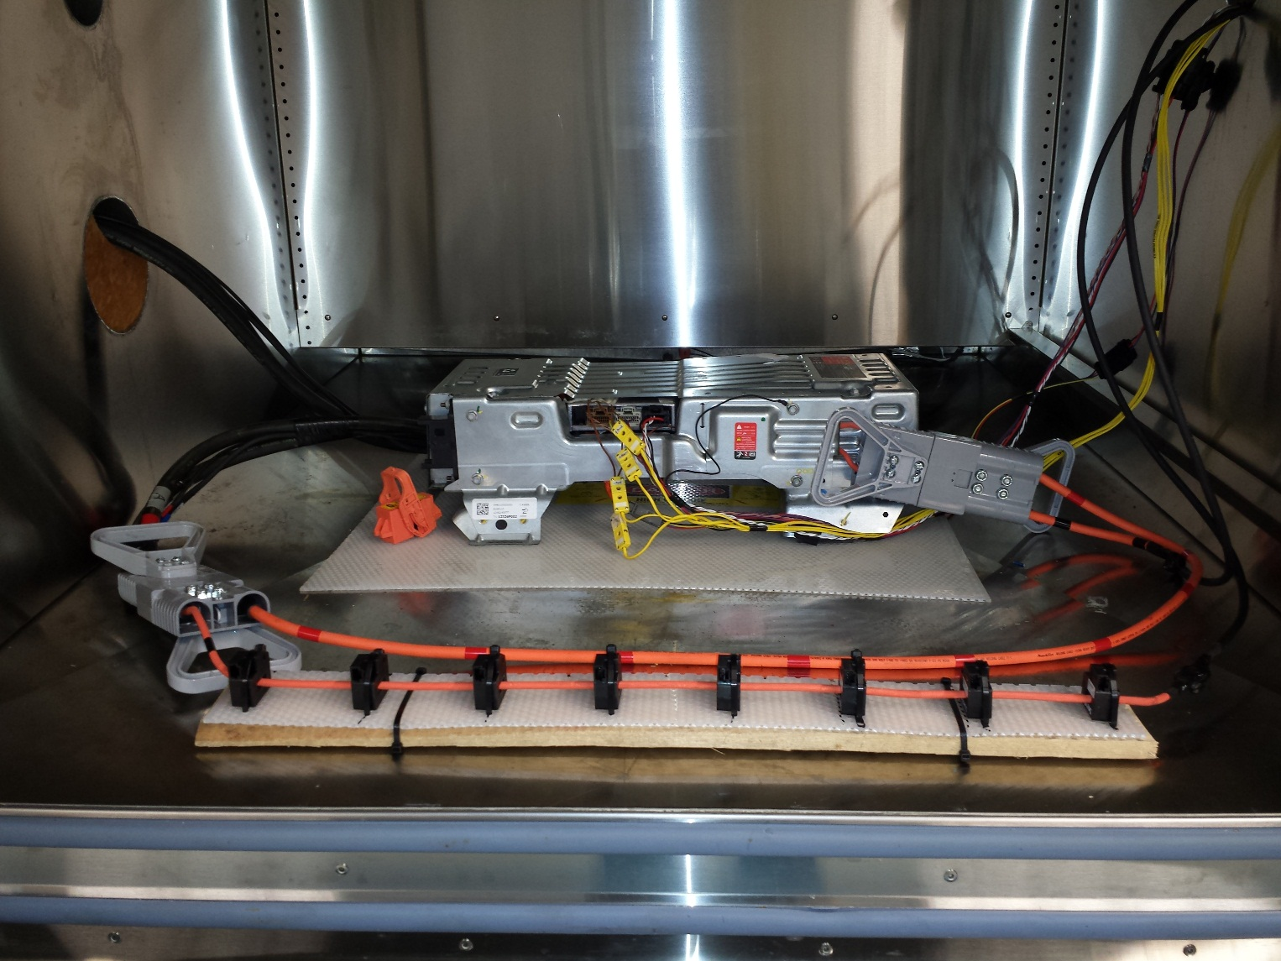
Optimization Details
I
D
D
O
V
Test setup
Environmental Chamber
Control temperature and humidity
BAS 3.0 Battery Pack
Current sensors under test
With negative HV line running through them
Wire to shunt
Shunt current is measured outside of chamber to avoid temperature differences
Notes:
Plot the data of your response. It is helpful to see the data that is used for summary statistics (i.e., S/N) before you analysis the Design of Experiment.
Give more detail as to the specifics of the optimization. Where appropriate, show the DOE matrix used as well as the analysis of the experiment. DELETE the examples when finished.

Slide 16
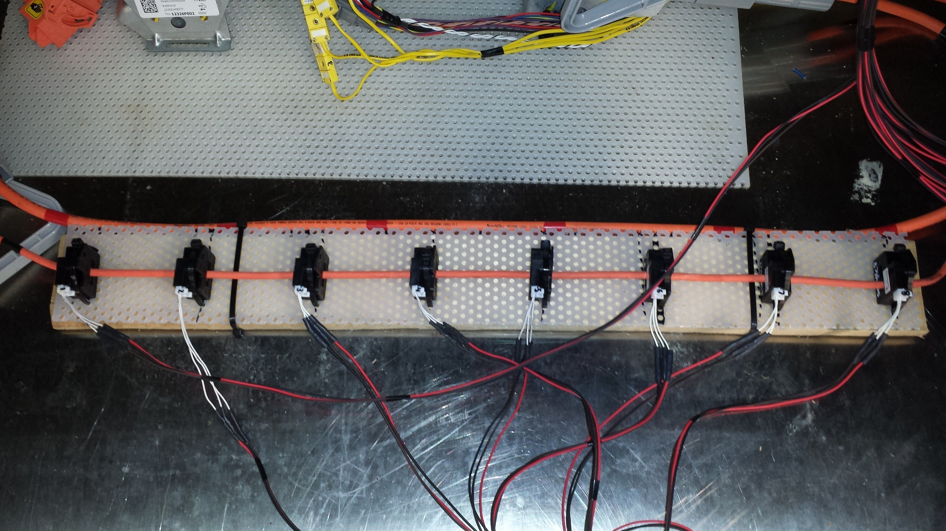
Optimization Details
I
D
D
O
V
Test setup
Each current sensor required 5V supply voltage supplied by the I/O rack. The I/O rack also measured the signal voltage for each sensor
Notes:
Plot the data of your response. It is helpful to see the data that is used for summary statistics (i.e., S/N) before you analysis the Design of Experiment.
Give more detail as to the specifics of the optimization. Where appropriate, show the DOE matrix used as well as the analysis of the experiment. DELETE the examples when finished.

Slide 17
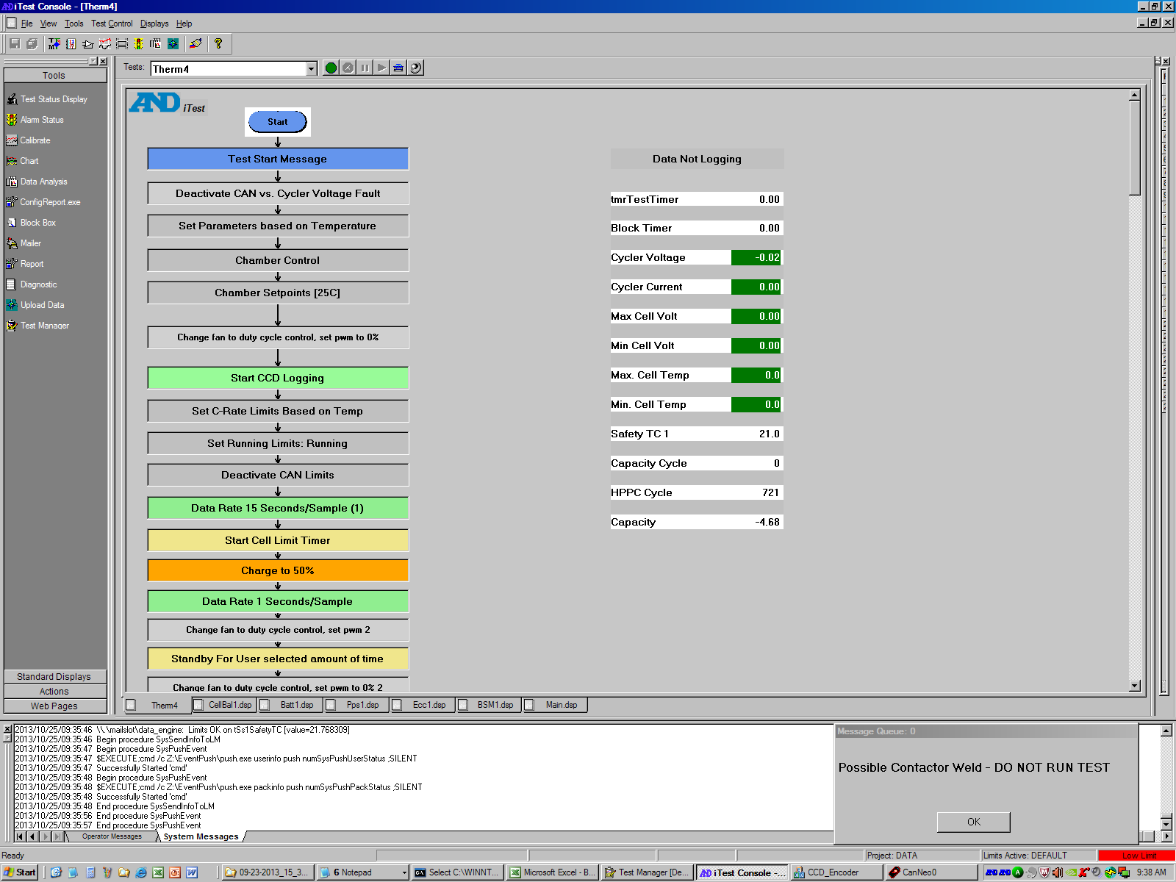
Optimization Details
I
D
D
O
V
Test setup
iTest software was used to perform each test case by controlling all the equipment and recording all of the data.
Notes:
Plot the data of your response. It is helpful to see the data that is used for summary statistics (i.e., S/N) before you analysis the Design of Experiment.
Give more detail as to the specifics of the optimization. Where appropriate, show the DOE matrix used as well as the analysis of the experiment. DELETE the examples when finished.

Slide 18
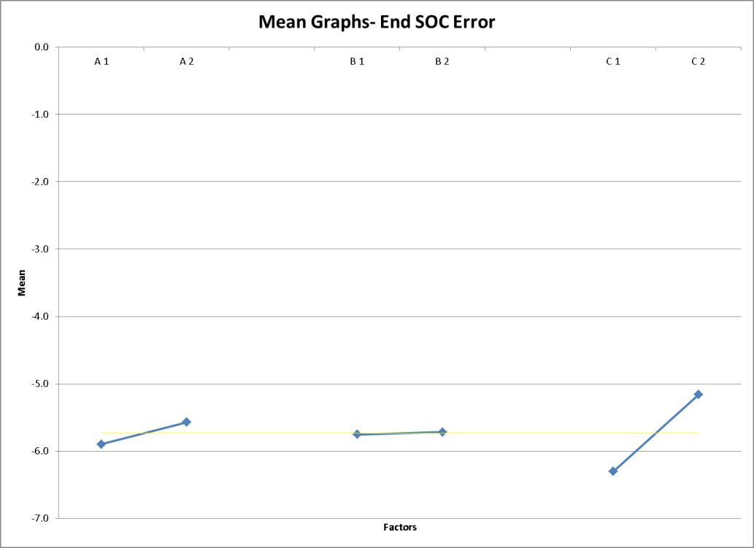
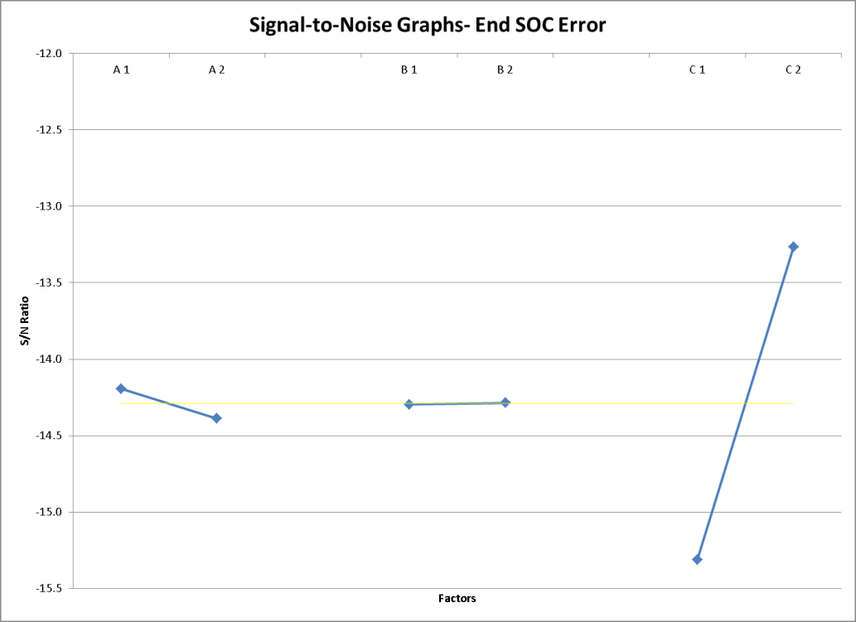
Response Plots
I
D
D
O
V
Nominal the Best
a1=small range | b1=high 1st stage gain
a2= large range | b2= low 1st stage gain
Notes:
Show a summary of what you did in the optimize phase. Present clearly what the results and conclusion are. If you used a DOE, the response plots are a quick why to show the results.

Slide 19
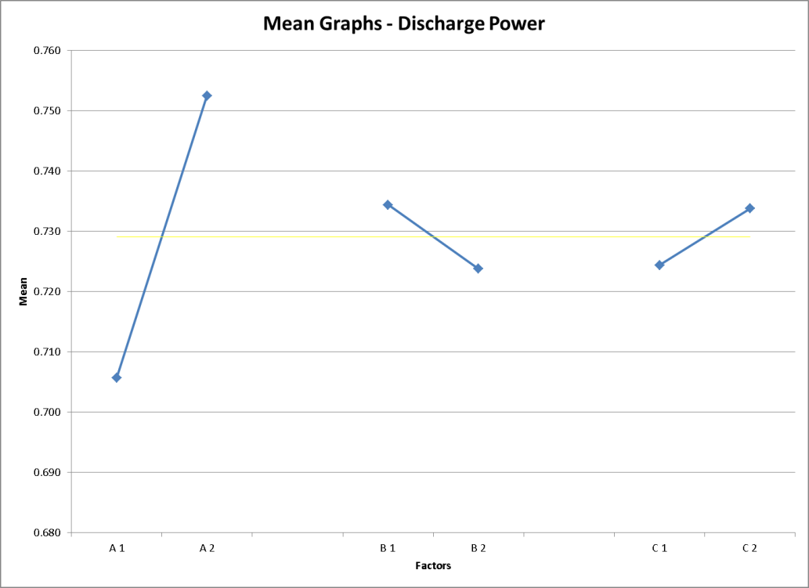

Response Plots
I
D
D
O
V
Nominal the Best
a1=small range | b1=high 1st stage gain
a2= large range | b2= low 1st stage gain
Notes:
Show a summary of what you did in the optimize phase. Present clearly what the results and conclusion are. If you used a DOE, the response plots are a quick why to show the results.

Slide 20
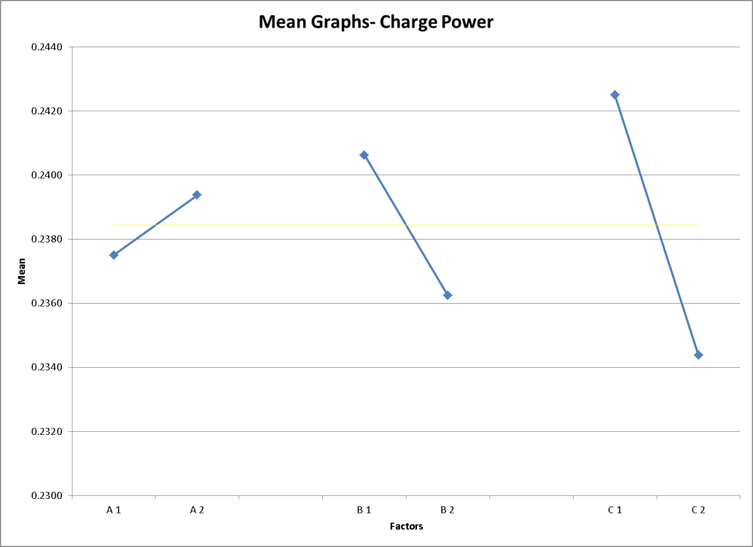
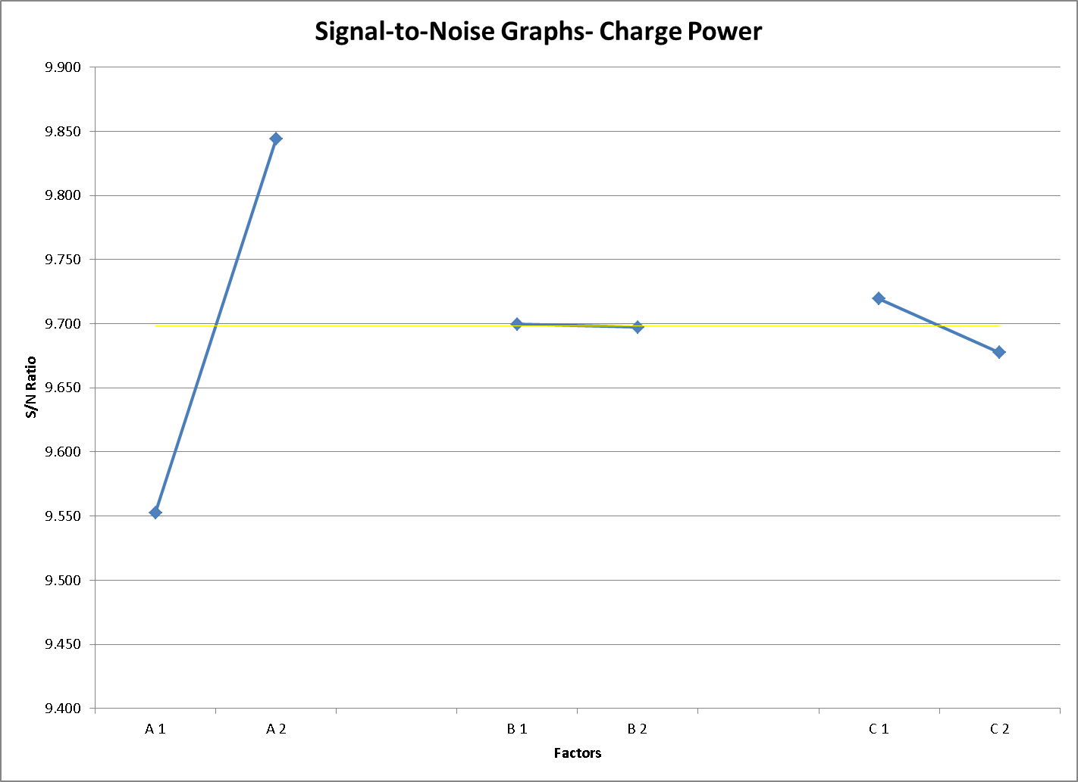
Response Plots
I
D
D
O
V
Nominal the Best
a1=small range | b1=high 1st stage gain
a2= large range | b2= low 1st stage gain
Notes:
Show a summary of what you did in the optimize phase. Present clearly what the results and conclusion are. If you used a DOE, the response plots are a quick why to show the results.

Slide 21
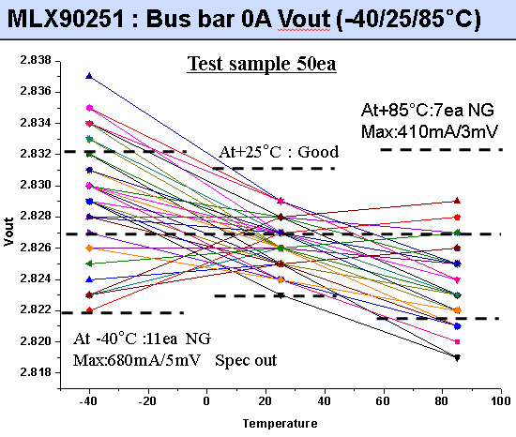
Verify Design Comparisons
I
D
D
O
V
Results of the study demonstrate a minimal gain in changes to the calibration to reduce the measured range. The results indicated a more significant impact of part-to-part variation than was achieved with the calibration. This was demonstrated in the contradicting results for different samples of the same sensor calibration showing a best and worst answer for some noise cases. Additionally, the signal-to-noise plots demonstrate that for charge and discharge power the control factors contradict each other.
The team has chosen not to change the current sensor calibration as it allows for a wider current range and will most likely see greater re-use in later programs.
Investigation of the part-to-part variation with the supplier has resulted in a proposed change to the current sensor chip (see analysis to right).
Notes:
However best demonstrated, compare the initial (baseline) and optimized designs. DELETE the example when finished.

Slide 22
Benefits
I
D
D
O
V
Identification of a method to analyze current sensor accuracy has been developed and can be re-used for future programs.
Quantitative analysis has demonstrated that the current sensor range is appropriate for this vehicle application.
Demonstrated that common parts for these applications are appropriate as the smaller current range program is not negatively affected.
Notes:
Quantify: Warranty reduction (IPTV, CPV), JD Power (PPH), etc. (improvement or avoidance)
Total cost savings and/or avoidance
Best practices for future designs

Slide 23
Recommended Future Work
I
D
D
O
V
Investigation around part-to-part variation should be conducted as shown in this work; a larger impact to BSE prediction was demonstrated than seen in the range calibrations.
Explore requirements to address part-to-part variation and its impact on charge, discharge, and SOC prediction error.
Recommend a change in IC for the current program to address variation seen in tested part.
Notes:
Classify the project deliverables according to these standard Closed-Loop Learning Process (CLLP) knowledge categories.

Slide 24
Implementation
I
D
D
O
V
No changes to the calibration are proposed as a result of this study.
Possible changes to the current sensor hall-effect IC will be investigated by Hannah Bence and Andrew Meintz and will be reviewed in the BAS3 and HEV4 PDTs.
Notes:
Include implementation plan with applicable details: design change, best practice, SOR change, standardize work, ect.
Include first program & future applications
What is the verification / validation plan?
Include timing & Responsible Engineer

Slide 25
Knowledge Capture & Share
I
D
D
O
V
This DFSS project will be reviewed in the Global Battery Systems team meeting.
Potential future update to requirements to capture effect of part-to-part variation will be suggested and reviewed within the systems engineering group. Updates to be included in RESS SSTS.
It is important to post the completed DFSS Project within your organization for knowledge share.
Notes:
The DFSS project posted in DFSS-GDM storage location is a record for certification purposes. The completed DFSS project and findings should be posted within your organization’s knowledge share.

Slide 26
Summary
This study demonstrated the effect of changing the calibration to reduce the current sensor range was not beneficial for the BAS3 and HEV4 programs.
Study appropriately demonstrated a method to analyze the range effects on the BSE and no range reduction benefit was identified. However, this study uncovered a need to better define requirements for part variation which was not completely understood before.
Analysis of the data was time consuming and would require additional resources.

Slide 27
Back-up Analysis

Slide 28
Part-to-Part Variation Confirmation
4-2. BAS3 Test data MLX90251 VS TLE4997: -40/+25/+85°C 24Hour
MLX90251 : Bus bar 0A Vout (-40/25/85°C) | TLE4997 : Bus bar 0A Vout (-40/25/85°C)
Test Sample 50ea (MLX90251) -. Calibrate 2,827±4mV at 0A -. -40/+25/+85°C 24Hour -. Apply 5V and measuring output. Output fluctuation at 0A (-40~+25°C) : -6mV Output fluctuation at 0A(+25~+85°C): +8mV At -40°C:11ea NG/ At +25°C:0ea NG/At +85°C:7ea NG | Test Sample 50ea (TLE4997) -. Calibrate 2,827±2mV at 0A -. -40/+25/+85°C 24Hour -. Apply 5V and measuring output. Output fluctuation at 0A (-40~+25°C) : -2mV Output fluctuation at 0A(+25~+85°C): +2mV All of Test sample meet Specification form -40°C to+85°C
Test sample 50ea
Test sample 50ea
At+85°C:7ea NG
Max:410mA/3mV
At +85°C : Good
At -40°C : Good
At+25°C : Good
At +25°C : Good
At -40°C :11ea NG
Max:680mA/5mV Spec out
6/8

Slide 29
SOC Evaluation
SOC Ahr – state of charge estimate based on current integration
Any error in current will be accumulated
SOC V – state of charge estimate based on modeling voltage characteristics of pack – open circuit voltage estimate
SOC Blended – blended estimate of Ahr and voltage SOC – actual reported SOC to outside world

Slide 30
City 25C Current Profile
RMS Current: 39.98

Slide 31
City 25C Deviation

Slide 32
City 25C SOC Ahr

Slide 33
City 25C SOC V

Slide 34
City 25C Blended SOC

Slide 35
City n10C Current Profile
RMS Current: 41.08

Slide 36
City n10C Deviation

Slide 37
City n10C SOC Ahr

Slide 38
City n10C SOC V

Slide 39
City n10C SOC Blended

Slide 40
US06 25C Current Profile
RMS Current: 62.99

Slide 41
US06 25C Deviation

Slide 42
US06 25C SOC Ahr

Slide 43
US06 25C SOC V

Slide 44
US06 25C SOC Blended

Slide 45
US06 40C Current Profile
RMS Current: 66.65

Slide 46
US06 40C Deviation

Slide 47
US06 40C SOC Ahr

Slide 48
US06 40C SOC V

Slide 49
US06 40C SOC Blended

Slide 50
City 25C SOC Deviation
SOC Ahr Deviation from shunt
SOC V Deviation from shunt
SOC Deviation from shunt

Slide 51
City 25C SOC Ideal Function

Slide 52
City 25C Percent Deviation in Charge Power Prediction

Slide 53
City 25C Chrg Power Ideal Function
Ideal based on measured power using Shunt Current Measurement and Cycler Voltage Measurement
*Capacity used was 5.119 Ahr

Slide 54
City 25C Percent Deviation in Discharge Power Prediction

Slide 55
City 25C Dschrg Power Ideal Function
Ideal based on measured power using Shunt Current Measurement and Cycler Voltage Measurement
*Capacity used was 5.119 Ahr

Slide 56
City n10C SOC Deviation
SOC Ahr Deviation from shunt
SOC V Deviation from shunt
SOC Deviation from shunt

Slide 57
City n10C SOC Ideal Function

Slide 58
City n10C Percent Deviation in Charge Power Prediction

Slide 59
City n10C Chrg Power Ideal Function
Ideal based on measured power using Shunt Current Measurement and Cycler Voltage Measurement
*Capacity used was 5.119 Ahr

Slide 60
City n10C Percent Deviation in Discharge Power Prediction

Slide 61
City n10C Dschrg Power Ideal Function
Ideal based on measured power using Shunt Current Measurement and Cycler Voltage Measurement
*Capacity used was 5.119 Ahr

Slide 62
US06 25C SOC Deviation
SOC Ahr Deviation from shunt
SOC V Deviation from shunt
SOC Deviation from shunt

Slide 63
US06 25C SOC Ideal Function

Slide 64
US06 25C Percent Deviation in Charge Power Prediction

Slide 65
US06 25C Chrg Power Ideal Function
Ideal based on measured power using Shunt Current Measurement and Cycler Voltage Measurement
*Capacity used was 5.119 Ahr

Slide 66
US06 25C Percent Deviation in Discharge Power Prediction

Slide 67
US06 25C Dschrg Power Ideal Function
Ideal based on measured power using Shunt Current Measurement and Cycler Voltage Measurement
*Capacity used was 5.119 Ahr

Slide 68
US06 40C SOC Deviation
SOC Ahr Deviation from shunt
SOC V Deviation from shunt
SOC Deviation from shunt

Slide 69
US06 40C SOC Ideal Function
Ideal based on measured power using Shunt Current Measurement and Cycler Voltage Measurement
*Capacity used was 5.119 Ahr

Slide 70
US06 40C Percent Deviation in Charge Power Prediction

Slide 71
US06 40C Chrg Power Ideal Function
Ideal based on measured power using Shunt Current Measurement and Cycler Voltage Measurement
*Capacity used was 5.119 Ahr

Slide 72
US06 40C Percent Deviation in Discharge Power Prediction

Slide 73
US06 40C Dschrg Power Ideal Function
Ideal based on measured power using Shunt Current Measurement and Cycler Voltage Measurement
*Capacity used was 5.119 Ahr

